Slide 1

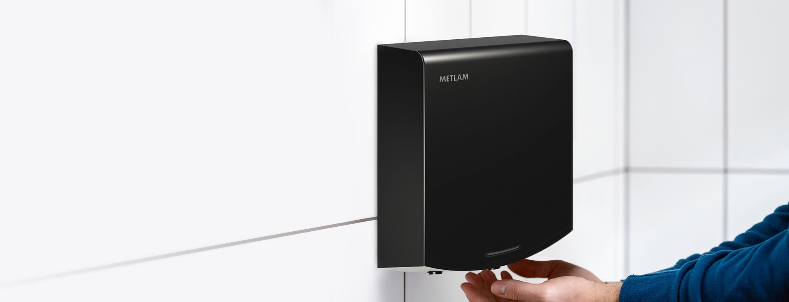
A Hand Dryer solution for every project and every budget, Metlam Australia has your requirements covered.
Metlam Australia Hand Dryers
Proudly Australian owned and
celebrating over 20 years in the market.
It's time to discover the difference!

Slide 2
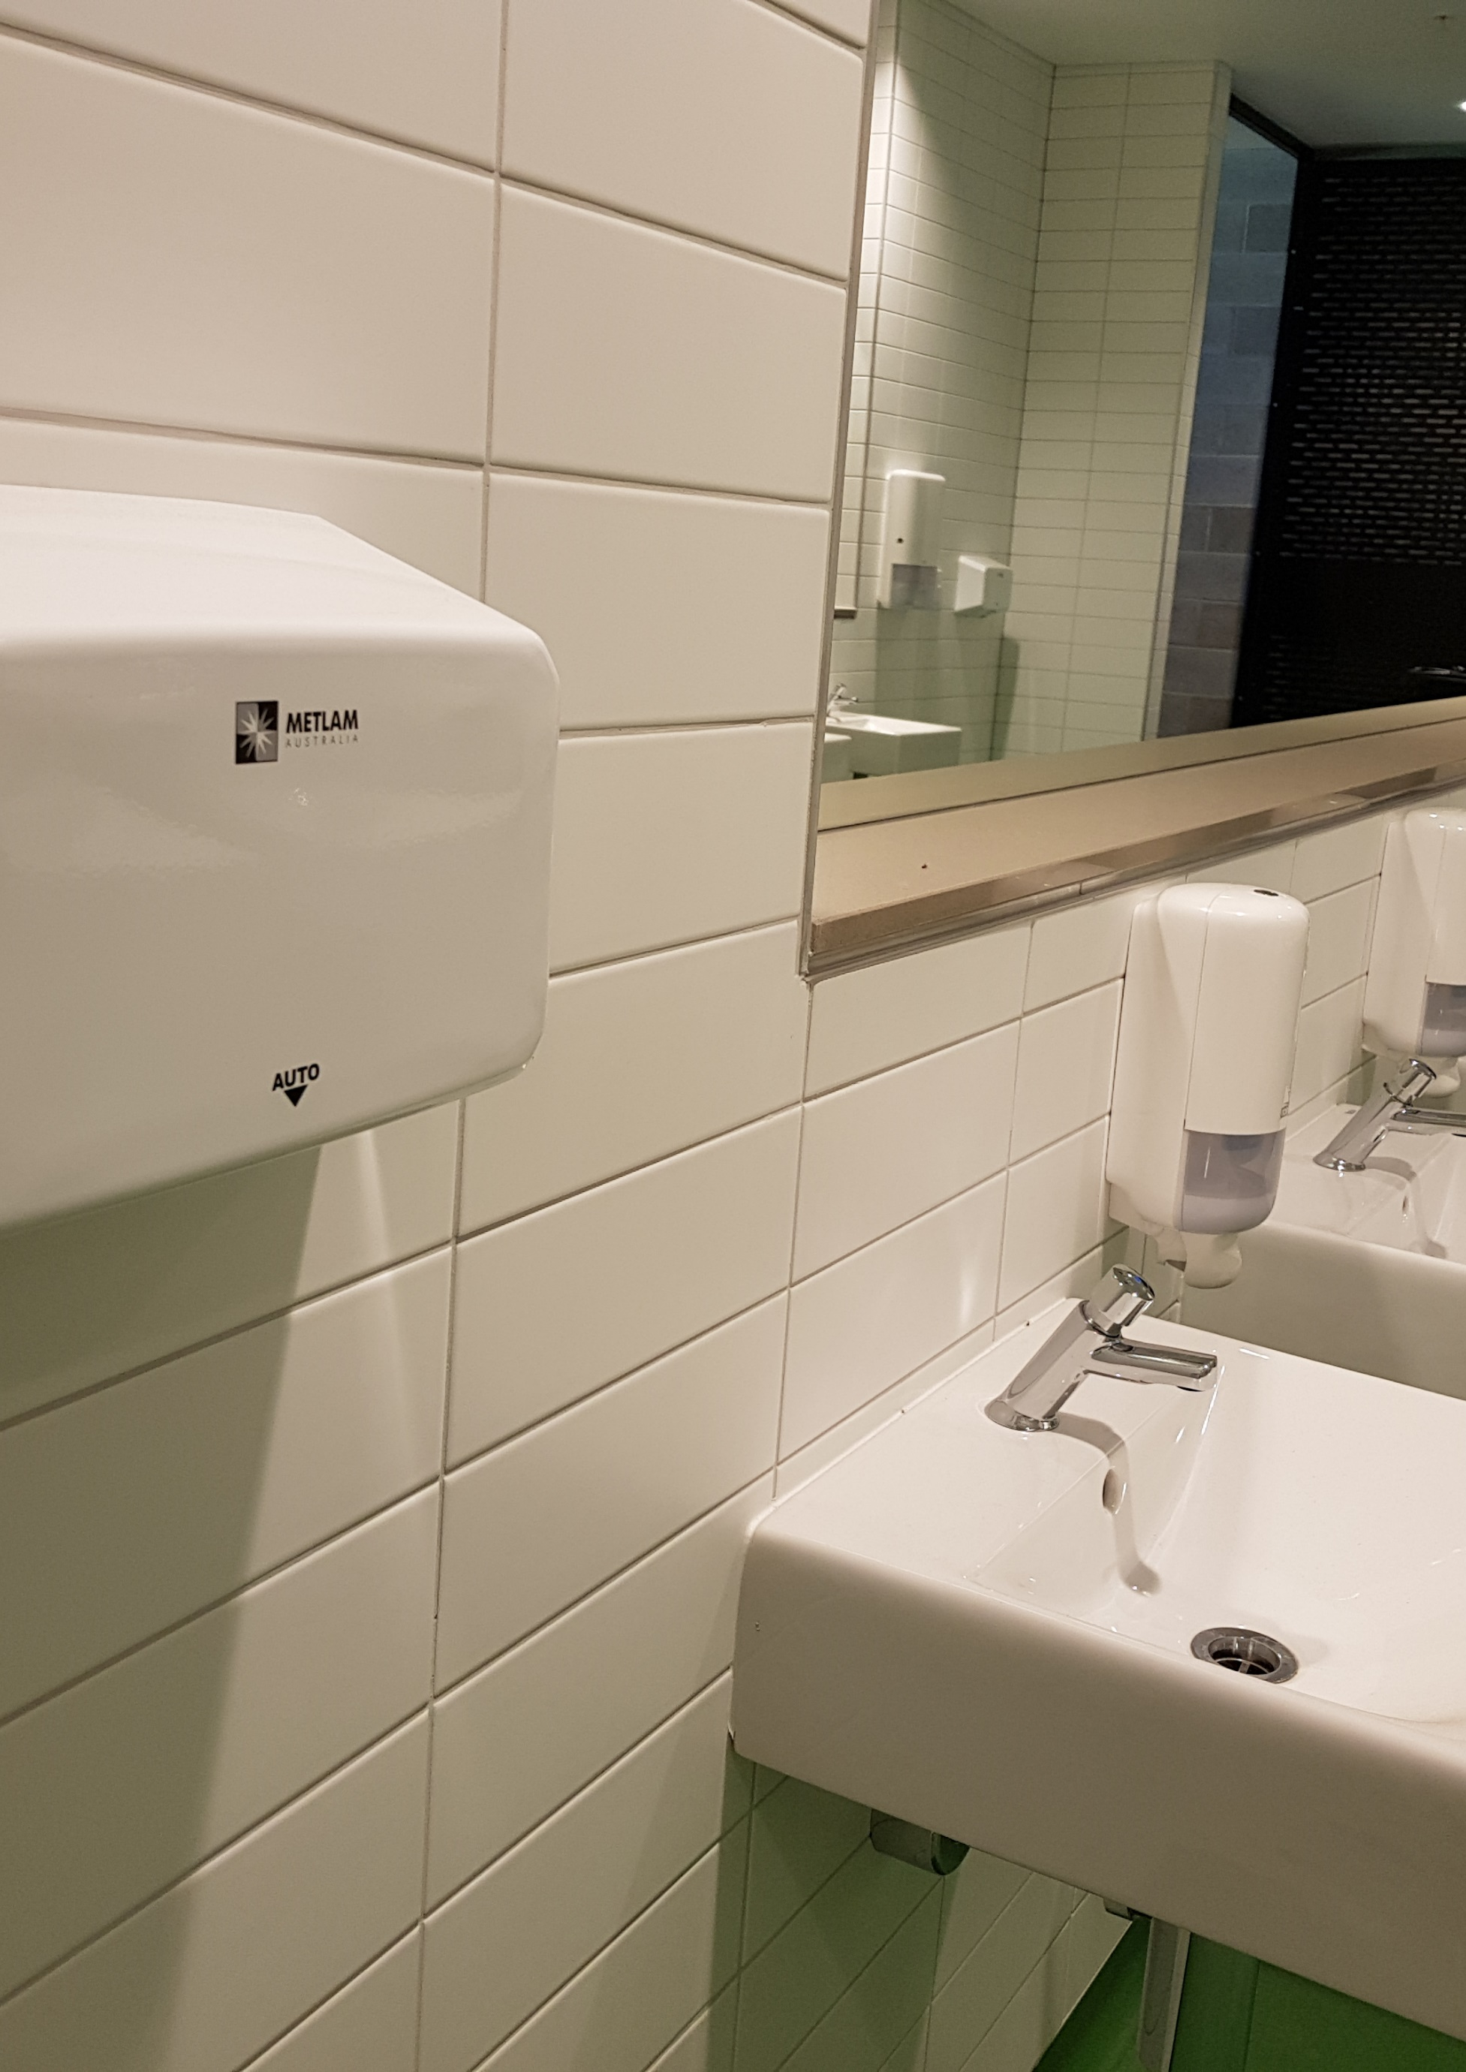
Celebrating over 20 years in operation,
Metlam Australia is a proud wholly Australian-owned and managed company specialising in the manufacture of quality Commercial Washroom Accessories and Toilet Partition Hardware for the commercial, residential, hospitality, health, science, care, education, security and public facilities markets.
Our Hand Dryers
Metlam Australia has a range of fast, efficient, functional and cost-effective hand dryers for every project requirement. Our range includes elements of innovative Australian design and local assembly - from slimline contemporary designs through to
ultra-efficient automatic high velocity drying. You can't go past Metlam Australia Hand Dryers to address any commercial washroom hand dryer requirements.
Our products are suitable for:
COMMERCIAL / INDUSTRIAL FACILITIES
HEALTH AND AGED CARE / RESEARCH FACILITIES
HOSPITALITY AND LEISURE FACILITIES
RESIDENTIAL FACILITIES
EDUCATIONAL FACILITIES
ACCESSIBLE COMPLIANT
PUBLIC FACILITIES

Slide 3

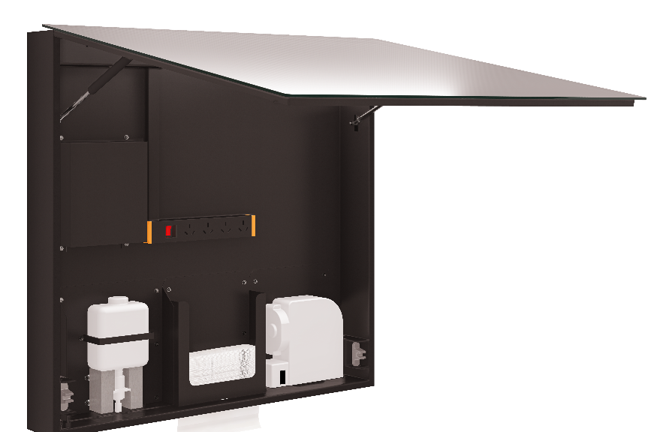
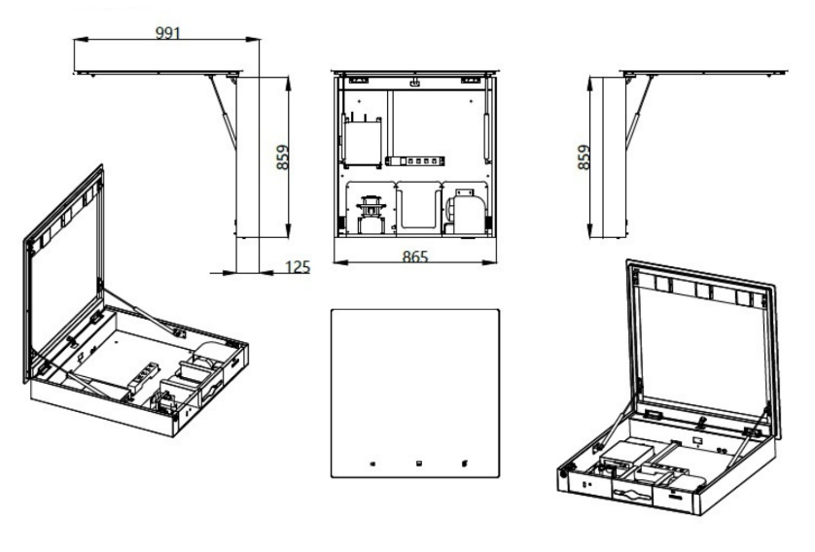
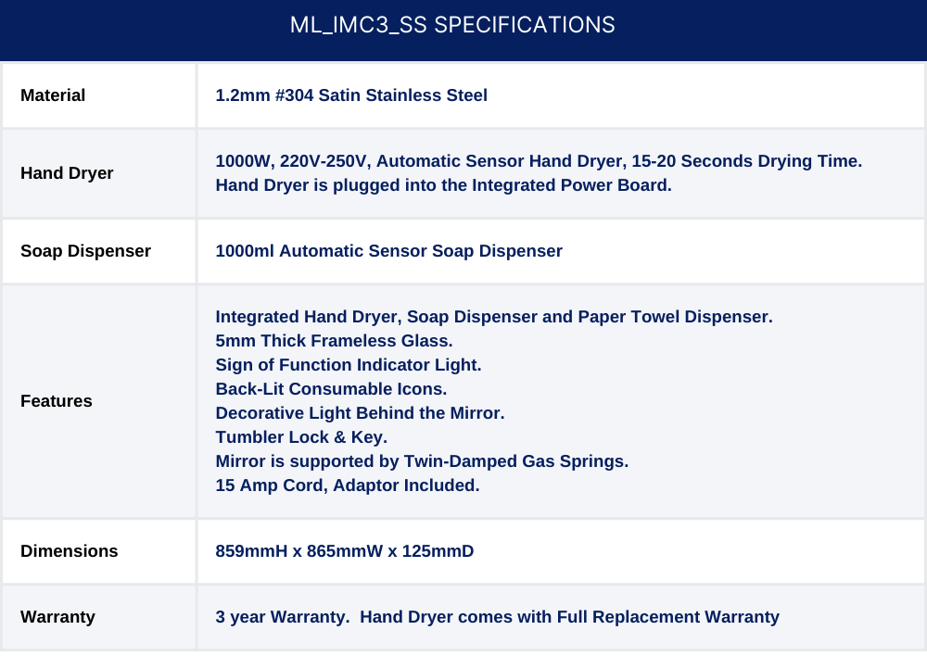
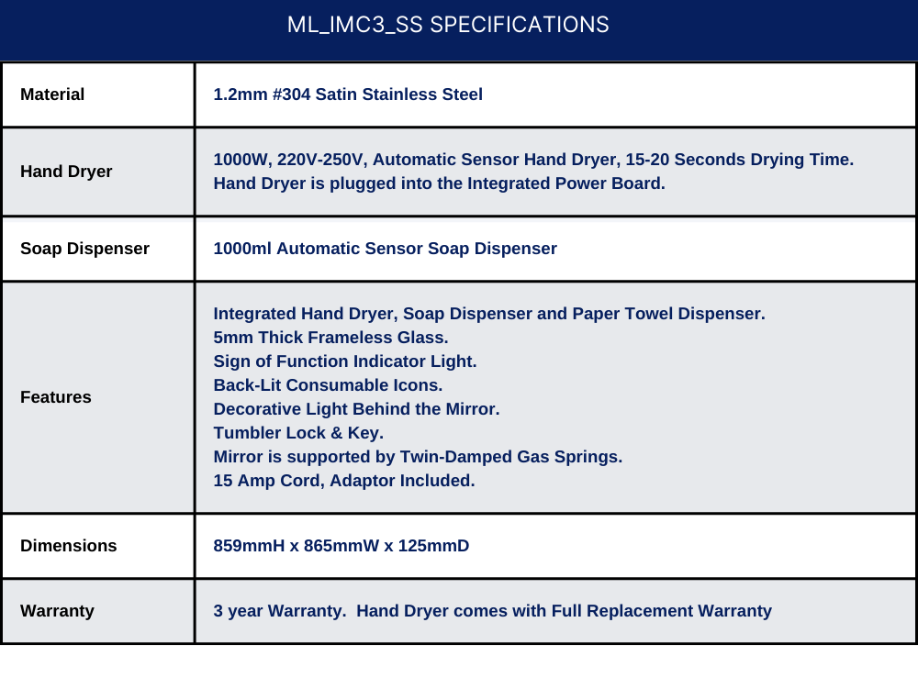





ML_IMC3_LUX
Integrated Mirror Cabinet – Includes Hand Dryer, Soap Dispenser & Paper Towel Dispenser
*Accessible compliant when installed in accordance with AS1428.1. guidelines.
Safety Approvals

Slide 4
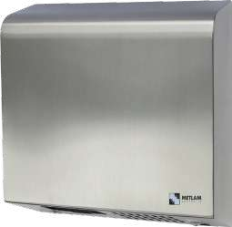
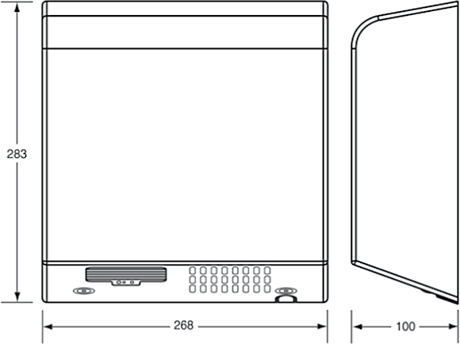
ML_100N_SS
Slimline Automatic Operation Hand Dryer
ML_100N_SS SPECIFICATIONS
Material | 1.2mm #304 Satin Stainless Steel
Motor | 1/4 HP, 7500 rpm, Brush Type, Dual Ball Bearings Motor, Thermal Protection-Auto Resetting Thermostat turns off at 105°C
Power Use | 230-240 Vac, 50/60Hz, 2200-2400W
Sound Level | 70db (+/-3)
Drying Time | Less than15 seconds
DP Rating | IPX 1
Element | 2200W @ 240VAC
Heater | 87°C auto resetting thermostat, 141°C auto reset safety cut off
Warm Air | Output: 314.5m3/h (185 CFM), Temp: Ambient +20°C
Protection | 60 sec power cut off, auto reset
Timing | 2 sec delay turn off after last read
Sensor/Range | Adjustable, standard 18cm ± 2cm
Case Security | 2 SS theft resistant hex drive screws (hex key supplied)
Net Weight | 4.5kg
Dimensions | 268mmW x 283mmH x 100mmD
Warranty | 5 Years (3 Years Parts and Labour + 2 Years Parts only)
Note | Unit can be hard wired by electrician or used with cord and plug provided
*Accessible compliant when installed in accordance with AS1428.1. guidelines.
Safety Approvals

Slide 5
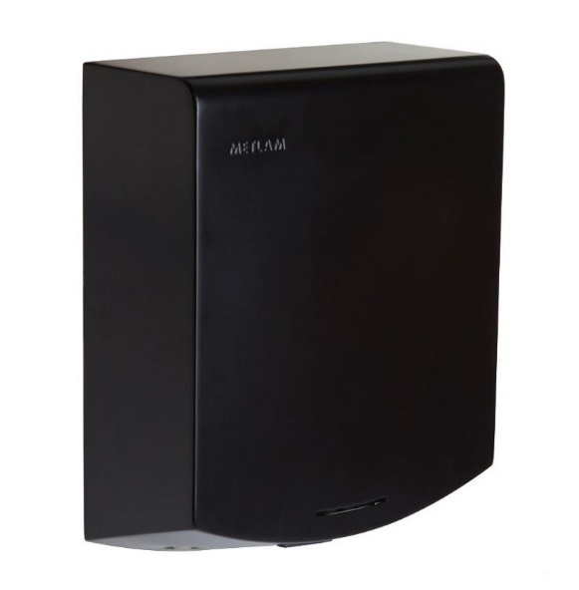
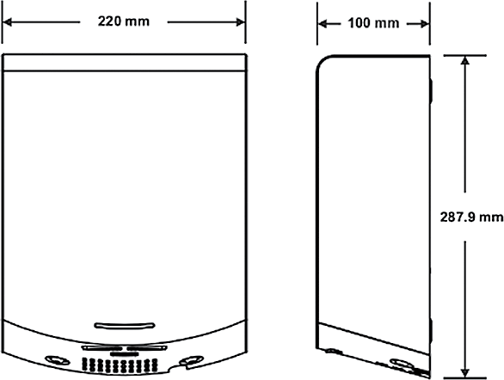

ML_ECLIPSE_DESIGNER
Slimline Automatic Operation Hand Dryer
ML_ECLIPSE_DESIGNER SPECIFICATIONS
Material | 1.2mm Designer Matte Black Powder Coat Steel
Features | Patented high-flow dual air outlets
Motor | 250-500W Brush Type: Dual Ball Bearings, 16,000-29,000 RPM, 95°C auto reset overload
Power Use | 220-240V, 50Hz, 1000W
Sound Level | 72 DB (+-3) @1M
Drying Time | Less than 15 seconds
DP Rating | IP 24
Element | 325 - 500W, adjustable
Heater | Auto resetting thermostat turns unit off at 85°C
Warm Air | Speed: 95-115m/s (adjustable), Temp: Ambient +25°
Protection | 60 sec power cut off, auto reset
Sensor/Range | Infrared Automatic - 152mm +/-20mm preset, Blue LED indicates operation/range
Case Security | 2 SS theft resistant hex drive screws (hex key supplied)
Net Weight | 4.2kg
Dimensions | 220mmW x 287.9mmH x 100mmD
Warranty | 5 Years (3 Years Parts and Labour + 2 Years Parts only)
Note | Unit can be hard wired by electrician or used with cord and plug provided
*Accessible compliant when installed in accordance with AS1428.1. guidelines.
Safety Approvals
Green Certificates

Slide 6
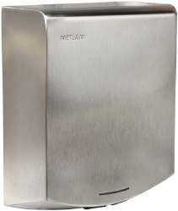
ML_ECLIPSE05_SS
Slimline Automatic Operation Hand Dryer
ML_ECLIPSE05_SS SPECIFICATIONS
Material | 1.2mm #304 Satin Stainless Steel
Features | Patented high-flow dual air outlets
Motor | 250-500W Brush Type: Dual Ball Bearings, 16,000-29,000 RPM, 95°C auto reset overload
Power Use | 220-240V, 50Hz, 1000W
Sound Level | 72 DB (+-3) @1M
Drying Time | Less than 15 seconds
DP Rating | IP 24
Element | 325 - 500W, adjustable
Heater | Auto resetting thermostat turns unit off at 85°C
Warm Air | Speed: 95-115m/s (adjustable), Temp: Ambient +25°
Protection | 60 sec power cut off, auto reset
Sensor/Range | Infrared Automatic - 152mm +/-20mm preset, Blue LED indicates operation/range
Case Security | 2 SS theft resistant hex drive screws (hex key supplied)
Net Weight | 4.2kg
Dimensions | 220mmW x 287.9mmH x 100mmD
Warranty | 5 Years (3 Years Parts and Labour + 2 Years Parts only)
Note | Unit can be hard wired by electrician or used with cord and plug provided
*Accessible compliant when installed in accordance with AS1428.1. guidelines.
Safety Approvals
Green Certificates

Slide 7
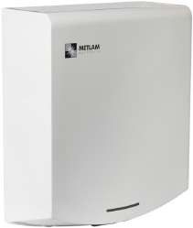
ML_ECLIPSE01_WHT
Slimline Automatic Operation Hand Dryer
ML_ECLIPSE01_WHT SPECIFICATIONS
Material | 1.2mm #304 White Powder Coat Steel
Features | Patented high-flow dual air outlets
Motor | 250-500W Brush Type: Dual Ball Bearings, 16,000-29,000 RPM, 95°C auto reset overload
Power Use | 220-240V, 50Hz, 1000W
Sound Level | 72 DB (+-3) @1M
Drying Time | Less than 15 seconds
DP Rating | IP 24
Element | 325 - 500W, adjustable
Heater | Auto resetting thermostat turns unit off at 85°C
Warm Air | Speed: 95-115m/s (adjustable), Temp: Ambient +25°C
Protection | 60 sec power cut off, auto reset
Sensor/Range | Infrared Automatic - 152mm +/-20mm preset, Blue LED indicates operation/range
Case Security | 2 SS theft resistant hex drive screws (hex key supplied)
Net Weight | 4.2kg
Dimensions | 220mmW x 287.9mmH x 100mmD
Warranty | 5 Years (3 Years Parts and Labour + 2 Years Parts only)
Note | Unit can be hard wired by electrician or used with cord and plug provided
*Accessible compliant when installed in accordance with AS1428.1. guidelines.
Safety Approvals
Green Certificates

Slide 8
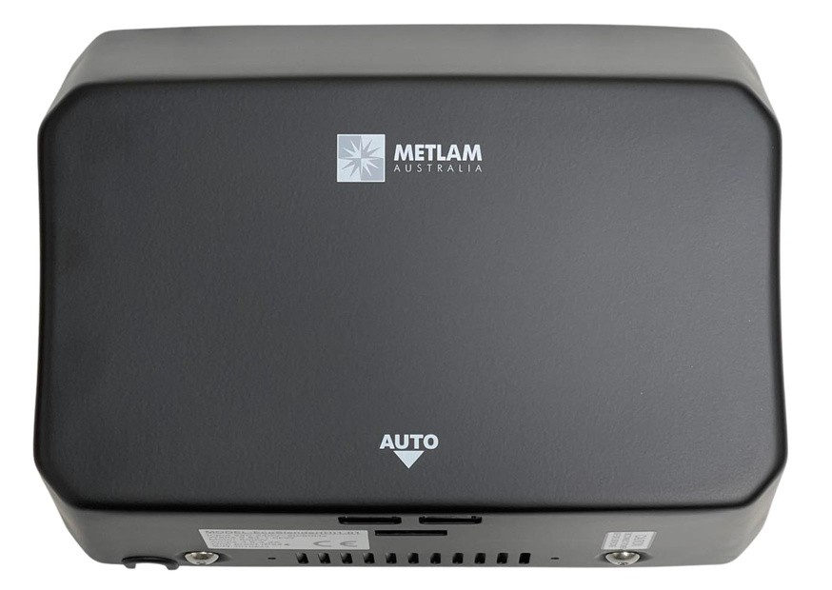
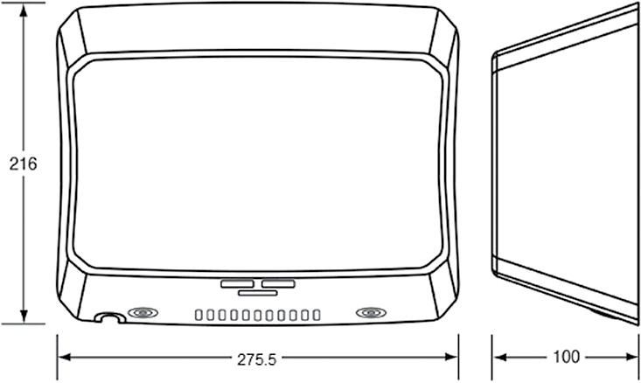



ML_ECOSLENDER_DESIGNER
Slimline Eco Automatic Operation Hand Dryer
ML_ECOSLENDER_DESIGNER SPECIFICATIONS
Material | 1.2mm Designer Matte Black Powder Coated Steel
Features | Contemporary curved design, Patented high-flow dual air outlets
Motor | Brush Type, Dual Ball Bearings, 16,000-29,000 RPM, 95°C auto reset overload
Power Use | 240V, 50Hz, 1000W, 4.17A
Sound Level | 68.9dB - 74.3dB (Adjustable)
Drying Time | Less than 15 seconds
DP Rating | IP 24
Element | 325 - 500W, (Adjustable)
Heater | ON/OFF Heating Options, 85°C auto resetting thermostat, 142°C auto reset safety cut off
Warm Air | Speed: 45.5-70m/s (adjustable), Temp: Ambient +25°C
Protection | 60 sec power cut off, auto reset
Sensor/Range | Infrared Automatic, Self Adjusting, 170mm+/-20mm, Blue LED indicates operation/range
Case Security | 2 SS theft resistant hex drive screws (hex key supplied)
Net Weight | 3.8kg
Dimensions | 275.5mmW x 216mmH x 100mmD
Warranty | 5 Years (3 Years Parts and Labour + 2 Years Parts only)
Note | Unit can be hard wired by electrician or used with cord and plug provided
*Accessible compliant when installed in accordance with AS1428.1. guidelines.
Safety Approvals
Green Certificates

Slide 9
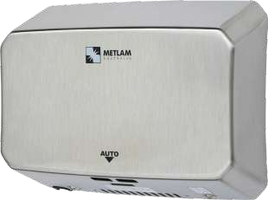

ML_ECOSLENDER05_SS
Slimline Eco Automatic Operation Hand Dryer
ML_ECOSLENDER05_SS SPECIFICATIONS
Material | 1.2mm #304 Satin Stainless Steel
Features | Contempory curved design, Patented high-flow dual air outlets
Motor | Brush Type, Dual Ball Bearings, 16,000-29,000 RPM, 95°C auto reset overload
Power Use | 240V, 50Hz, 1000W, 4.17A
Sound Level | 68.9dB - 74.3dB (Adjustable)
Drying Time | Less than 15 seconds
DP Rating | IP 24
Element | 325 - 500W, (Adjustable)
Heater | ON/OFF Heating Options, 85°C auto resetting thermostat, 142°C auto reset safety cut off
Warm Air | Speed: 45.5-70m/s (adjustable), Temp: Ambient +25°C
Protection | 60 sec power cut off, auto reset
Sensor/Range | Infrared Automatic, Self Adjusting, 170mm+/-20mm, Blue LED indicates operation/range
Case Security | 2 SS theft resistant hex drive screws (hex key supplied)
Net Weight | 3.8kg
Dimensions | 275.5mmW x 216mmH x 100mmD
Warranty | 5 Years (3 Years Parts and Labour + 2 Years Parts only)
Note | Unit can be hard wired by electrician or used with cord and plug provided
*Accessible compliant when installed in accordance with AS1428.1. guidelines.
Safety Approvals
Green Certificates
*Accessible compliant when installed in accordance with AS1428.1. guidelines.

Slide 10
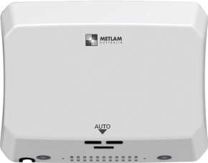


ML_ECOSLENDER01_WHT
Slimline Eco Automatic Operation Hand Dryer
ML_ECOSLENDER01_WHT SPECIFICATIONS
Material | 1.2mm #304 White Powder Coat Steel
Features | Contemporary curved design, Patented high-flow dual air outlets
Motor | Brush Type, Dual Ball Bearings, 16,000-29,000 RPM, 95°C auto reset overload
Power Use | 240V, 50Hz, 1000W, 4.17A
Sound Level | 68.9dB - 74.3dB (Adjustable)
Drying Time | Less than 15 seconds
DP Rating | IP 24
Element | 325 - 500W, (Adjustable)
Heater | ON/OFF Heating Options, 85°C auto resetting thermostat, 142°C auto reset safety cut off
Warm Air | Speed: 45.5-70m/s (adjustable), Temp: Ambient +25°C
Protection | 60 sec power cut off, auto reset
Sensor/Range | Infrared Automatic, Self Adjusting, 170mm+/-20mm, Blue LED indicates operation/range
Case Security | 2 SS theft resistant hex drive screws (hex key supplied)
Net Weight | 3.8kg
Dimensions | 275.5mmW x 216mmH x 100mmD
Warranty | 5 Years (3 Years Parts and Labour + 2 Years Parts only)
Note | Unit can be hard wired by electrician or used with cord and plug provided
*Accessible compliant when installed in accordance with AS1428.1. guidelines.
Safety Approvals

Slide 11
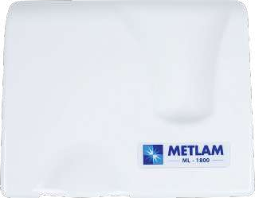
ML_1800_WHT
Automatic Operation ABS Hand Dryer
216.99
259.99
179.99
ML_1800_WHT SPECIFICATIONS
Casing | 3.0mm White High-Grade Fire-Retardant ABS
Motor | 80W Brushless, 2850 RPM, 105°C auto reset overload
Power Use | 240V, 50Hz, 1800W, 7.50A
Sound Level | 55db (+/- 3)
Drying Time | 30-35 seconds
DP Rating | IPX 1
Heater | 87°C auto resetting thermostat, 142°C auto reset safety cut off
Warm Air | Speed: 14.5m/s, Temp: Ambient +20°C
Protection | 60 sec power cut off, auto reset
Timing | 2 sec delay turn off after last read
Sensor/Range | Auto Infrared - 180mm +/-20mm preset, 100 - 300mm adjust
Case Security | 2 SS theft resistant hex drive screws (hex key supplied)
Net Weight | 3.5kg
Dimensions | 259.99mmW x 216.99mmH x 179.99mmD
Warranty | 5 Years (3 Years Parts and Labour + 2 Years Parts only)
Note | Unit can be hard wired by electrician or used with cord and plug provided
Safety Approvals
Green Certificates

Slide 12
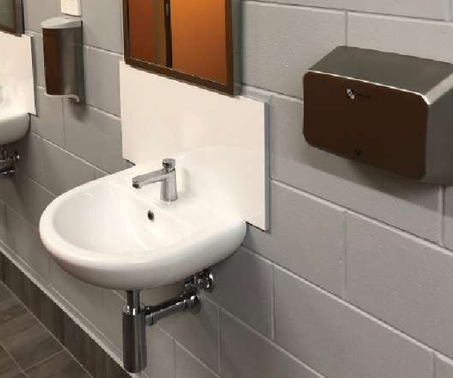

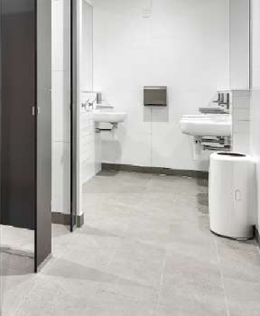
Warren Park Rugby League Stadium, NT
Optus Stadium, WA
Ashmore City Shopping Centre, QLD

Slide 13
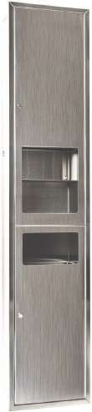
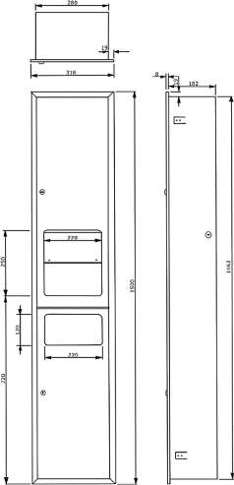
ML_ECLIPSE_3N1REC_D
Recessed Paper Towel Dispenser, Hand Dryer & Waste Receptacle
ML_ECLIPSE_3N1REC_D SPECIFICATIONS
Material/Finish | #304 Satin Stainless Steel
Features | Unit fitted with security lock, Seamless welds, rolled edges
Dispenser/ Option | 300 Interfold paper towels, 500 Interleaved paper towels
Hand Dryer | Eclipse Auto Dryer
Warranty | 5 Years (3 Years Parts and Labour + 2 Years Parts only)
Motor | 250-500W Brush Type, Dual Ball Bearings, 29,000 RPM, 95°C auto reset overload
Power Use | 240V, 50Hz, 1000W
Power Supply | Hard wired - 4 electrical cable entry points available
Drying Time | Less than 15 seconds
DP Rating | IP 24
Heater | 85°C auto reset safety cut off
Warm Air | Speed: 70m/s, Temp: Ambient +25°C
Protection | 60 sec power cut off, auto reset
Disposal | 21L Removable Stainless Steel waste container
Overall Size | 318mmW x 1500mmH x 190mmD
Wall Opening | 290mmW x 1472mmH x 192mmD
Note | Unit is to be hard wired by licensed electrician, Unit is supplied with 2 keys
*Accessible compliant when installed in accordance with AS1428.1. guidelines.
Safety Approvals
Green Certificates

Slide 14
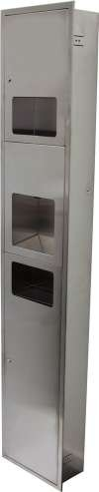
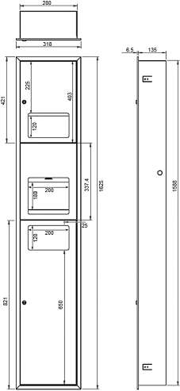





ML_ECO_73N1REC
Recessed Paper Towel Dispenser, Receptacle Hand Dryer & Waste
ML_ECO_73N1REC SPECIFICATIONS
Material/Finish | #304 Satin Stainless Steel
Features | Unit fitted with security lock, Full length piano hinge on doors, Seamless welds, rolled edges
Dispenser/ Option | 300 Interfold paper towels, 500 Interleaved paper towels
Hand Dryer | EcoFast Auto Dryer
Warranty | 5 Years (3 Years Parts and Labour + 2 Years Parts only)
Motor | 500W Brush Type: Dual Ball Bearings, 29,000RPM 105°C auto resetting safety overload thermostat
Power Use | 240V, 50Hz, 1000W, 4.17A
Power Supply | Hard wired - 4 electrical cable entry points available
Drying Time | Less than 15 seconds
DP Rating | IPX1
Heater | 85°C auto reset safety cut off
Warm Air | Speed: 90m/s, Temp: Ambient +30°C
Protection | 60 sec power cut off, auto reset
Disposal | 20L Removable Stainless Steel waste container
Overall Size | 318mmW x 1625mmH x 141.5mmD
Wall Opening | 290mmW x 1600mmH x 145mmD
Specify | Recessed
Note | Unit is to be hard wired by licensed electrician. Unit is supplied with 2 keys
Safety Approvals
Green Certificates

Slide 15
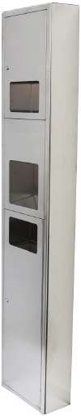
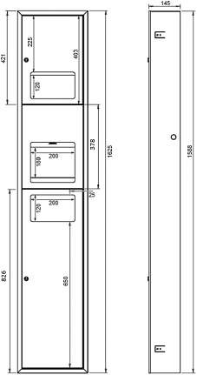
ML ECO 73N1SM
Surface Mount Paper Towel Dispenser, Receptacle Hand Dryer
& Waste
ML_ECO_73N1SM SPECIFICATIONS
Material/Finish | #304 Satin Stainless Steel
Features | Unit fitted with security lock, Full length piano hinge on doors, Seamless welds, rolled edges
Dispenser/ Option | 300 Interfold paper towels / 500 Interleaved paper towels
Hand Dryer | Eco Auto Dryer
Warranty | 5 Years (3 Years Parts and Labour + 2 Years Parts only)
Motor | 500W Brush Type: Dual Ball Bearings, 29,000RPM 105°C auto resetting safety overload thermostat
Power Use | 240V, 50Hz, 1000W, 4.17A
Power Supply | Hard wired - 4 electrical cable entry points available
Drying Time | Less than 15 seconds
DP Rating | IPX1
Heater | 85°C auto reset safety cut off
Warm Air | Speed: 90m/s, Temp: Ambient +30°C
Protection | 60 sec power cut off, auto reset
Disposal | 20L Removable Stainless Steel waste container
Overall Size | 318mmW x 1625mmH x 141.5mmD
Specify | Surface Mounted
Note | Unit is to be hard wired by licensed electrician. Unit is supplied with 2 keys
Safety Approvals
Green Certificates

Slide 16
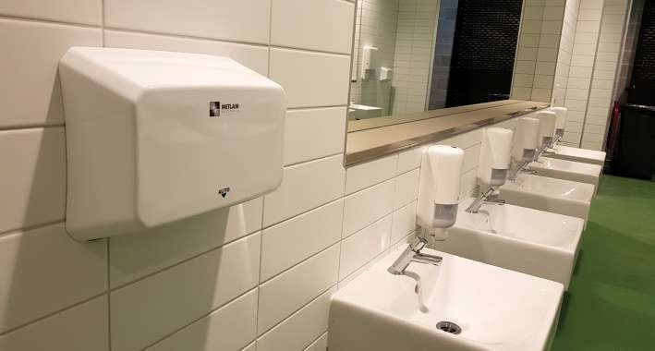
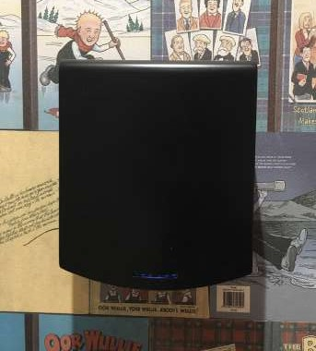
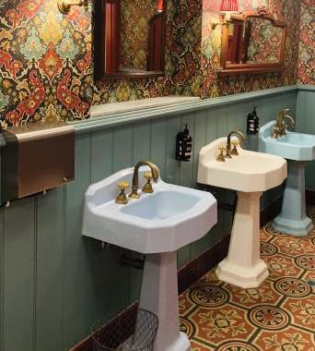
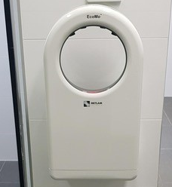
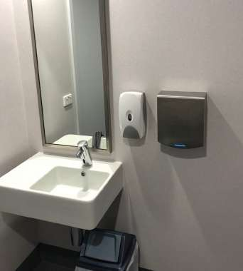
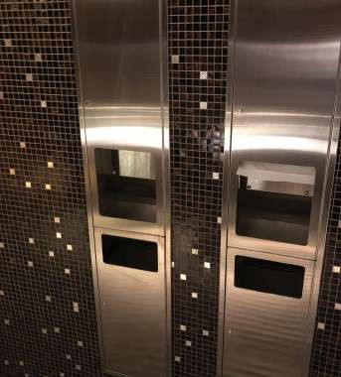
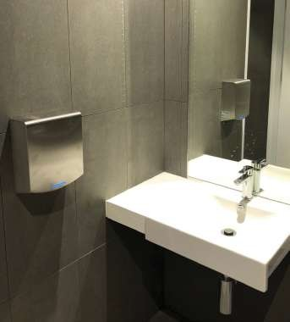
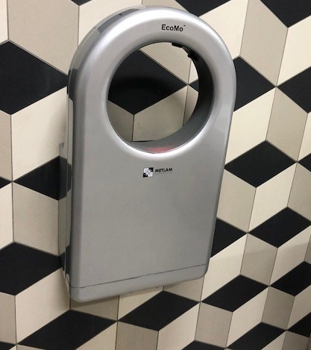
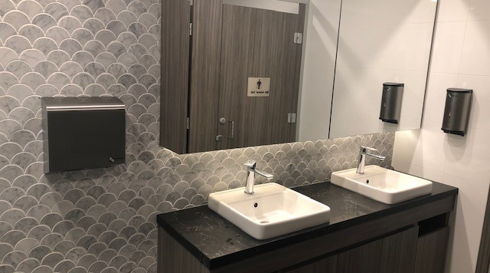
Optus Stadium, WA
Maryborough Highland Society, VIC
Our Hand Dryers have been used in countless projects across market segments throughout Australasia.
Metlam Australia has a
Hand Dryer solution for every project and budget.
Martial Arts Centre, Liverpool NSW
Hotel Esplanade, VIC
The Lights Community and Sports Centre, SA
Waikerie Recreation Centre, SA
Melbourne Recital Centre, VIC
The Lights Community and Sports Centre, SA
McDonalds,
South Melbourne Vic
146 Marsden Street, Parramatta NSW

Slide 17
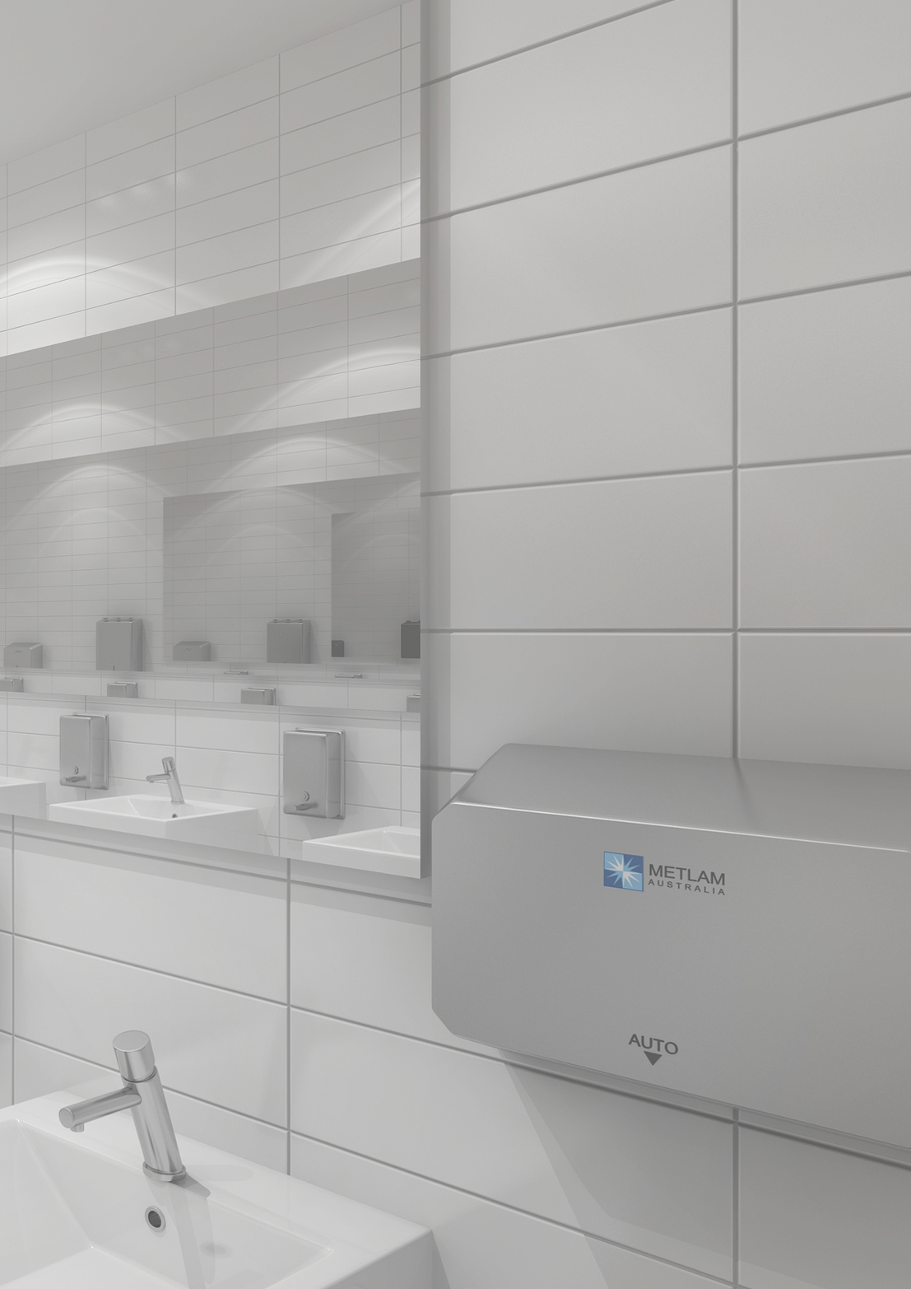

For further information on our product range please contact us at:
1300 Metlam for all calls inside Australia
Head Office: 17 Parkers Road, New Gisborne VIC 3438
T: +61 3 5420 8800
E: sales@metlam.com.au
Website: www.metlam.com.au
The technical recommendations contained in this document are necessarily of a general nature and should not be relied on for specific applications without first securing competent advice. Whilst Metlam Australia Pty Ltd has taken all reasonable steps to ensure the information contained herein is accurate and current, it does not warrant the accuracy or completeness of the information and does not accept liability for errors or omissions. Any commercial product should only be installed by a competent tradesperson and serviced/maintained by knowledgeable janitorial staff or competent people. Metlam Australia accepts no responsibility for any damage to product, walls or fixtures due to incorrect installation or maintenance of any of their products.

